Slide 1
BFX-UA300 (96.1517T00) RMA
Power Button Feeling NG Report
Prepared by: Pham Huy Thuc
Approved by: Michael
Date: Aug 13th 2022

Slide 2
D1. Establish the Team
Team Leader
Team Member
PE: Michael, Thuc
ME: Cheng Lun, Wen Thai
PM: Ben Zheng, An Tran
PD: Ruan Wen Yong
QA: Ken, Rachel
TE: Mark Wu, Allan Pham
IE: Hai Ly, Heng Ruan
Foxconn
  MFG Director: David Yin
  QA Manager : CB Lin, Toney

Slide 3
D2. Description
1. Issue Description
- On 30/06/2022, ALT customer complaint 1pcs has Power button feeling NG.
- Failure status: Unusual feeling when pressing the Power button.
Failure information:
NO# | FXC_SN | Cus_SN | MAC | Symptom
1 | YWR0J97 | 2149695001202201006506 | A8934AFEBBC6 | Power button feeling NG

Slide 4
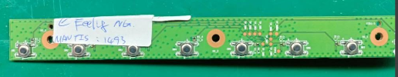

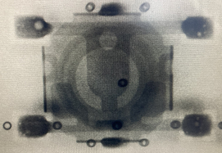
D3. Containment
1. Visual Inspection PCBA both of Button NG sample.
Visual Inspection ➔ Both top & bot side of defect unit are normal.
Top side
Bot side
Take X-ray SW1 ( Power button)➔ Normal
X-ray SW1

Slide 5
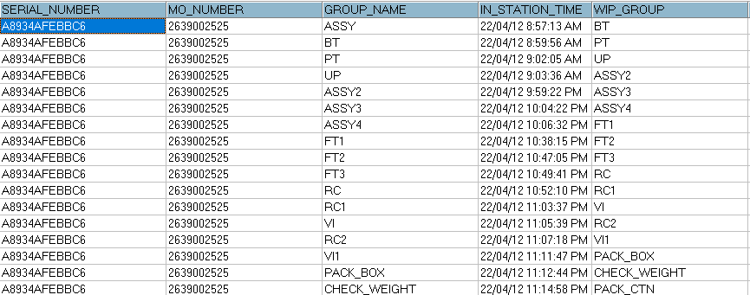
D3. Containment
2. Check FATP data record
Check FATP data record: NG product tested pass at FATP
Summary: NG product didn’t have abnormal on FATP.

Slide 6
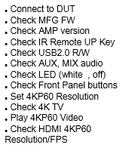
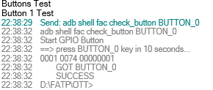
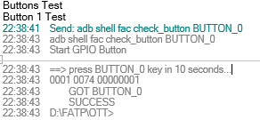
D4. Root Cause
1. Check log test at FATP
Check log test is normal
...
FT1
...
Test plan FT1 station
Power Button Tested Pass First Time
Power Button Tested Pass Second Time
Summary: Button function is tested pass twice at FT1 station.

Slide 7
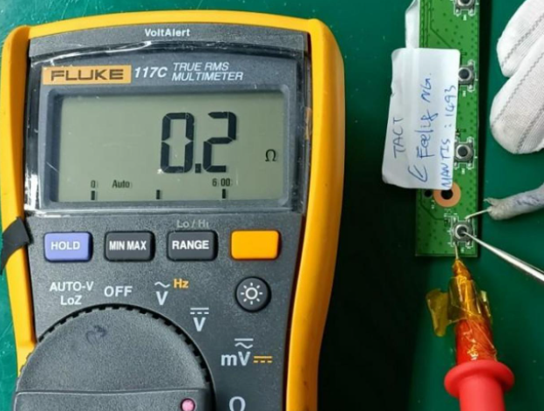
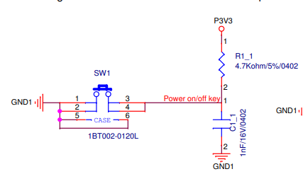
D4. Root Cause
2. Check Connection of SW1 Button
Check the connection of button by pressing the button and measuring two pins ( pin 1 & pin 4) with multimeter
➔ Multimeter display 0.2Ω
Multimeter display connection is OK
Circuit diagram of SW1 block
Summary:
- Case 1: Press SW1 key button ➔ Pin 1 & pin 4 are connected to each other
- Case 2: No press SW1 button ➔ Pin 1 & pin4 is open

Slide 8
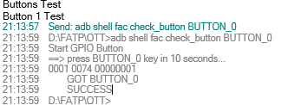
D4. Root Cause
3. Re-test Button Function At FT1 Station.
Reassemble Button main and retest button function 5 times FT1 station ➔ Button function Pass normally.
Button function Pass at FT1
Test Time Button Function Test | 1 | 2 | 3 | 4 | 5
Result | Pass | Pass | Pass | Pass | Pass
Summary: Retest Button function 5 times at FT1 station ➔ Result: Pass 5/5 times

Slide 9
D4. Root Cause
4. Re-test Button Function by pressing.
Retest Power Button Function by pressing button 10 times ( Display shows on/off)
Test Time Button Function Test | 1 | 2 | 3 | 4 | 5 | 6 | 7 | 8 | 9 | 10
Result | Pass | Pass | Pass | Pass | Pass | Pass | Pass | Pass | Pass | Pass
Summary: Retest Power Button Function by pressing button 10 times ➔ Result: Pass 10/10 times

Slide 10

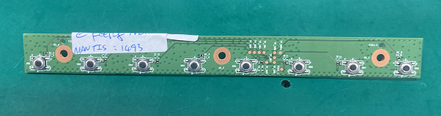
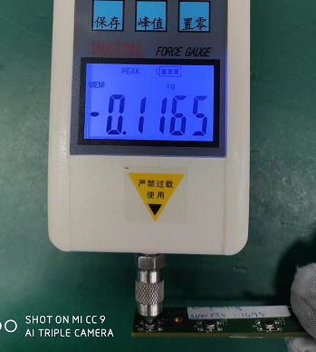
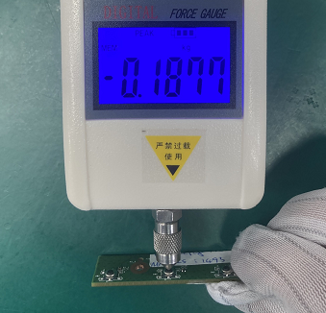
5. Measure Pressure button.
Fii confirm with Vendor and check push force of the switch define was:
160 +/- 50 gf (Lower spec : 110 g.f/ /Upper spec :210 g.f)
Fii uses a force gauge to check the status of the actual switches on the PCBA of customer feedback. Measurement results as below: (Unit:Kgf).
Location Sample | 1 | 2 | 3 | 4 | 5 | 6 | 7 | 8
Customer PCBA | 0.1165 | 0.1870 | 0.1693 | 0.1845 | 0.1797 | 0.1705 | 0.1834 | 0.1877
Factory 1# | 0.1635 | 0.1706 | 0.1844 | 0.1905 | 0.1673 | 0.1877 | 0.1688 | 0.1745
Factory 2# | 0.1655 | 0.1745 | 0.1733 | 0.1715 | 0.1875 | 0.1902 | 0.1808 | 0.1685
Factory 3# | 0.1682 | 0.1733 | 0.1845 | 0.1854 | 0.1705 | 0.1692 | 0.1917 | 0.1672
Factory 4# | 0.1873 | 0.1752 | 0.1862 | 0.1783 | 0.1646 | 0.1872 | 0.1935 | 0.1841
1
2
3
4
5
6
7
8
Remark :
1.Power button (Position 1) force value near lower limit , but have not over the limit of control other positions are within defined specification.
2.Check that 4 PCBA with switch component in the factory are in standard specifications.
3.Feedback results with SQE & PQE to confirm and continue to analyze further with the material incoming and FATP process.
Defect NG
Sample
~ 1 ~

Slide 11
D4. Root Cause
6. Conclusion Root cause.
Retest NG sample on FATP ( Focus on FT1 station to check button function )➔ Pass normally
This issue ( Unusual feeling when pressing the Power button) doesn’t affect to it’s function.
Fii uses a force gauge to check the status of the actual switches on the PCBA of customer feedback. Measurement results are in standard specifications.
Feedback this results with vendor to confirm and continue to analyze further with FATP process.

